Slide 1
CHAPTER – 1
OVERVIEW

Slide 2
TOPICS
Data Communication
  Components
  Representations
  Data Flow
Networks
  Network criteria
  Physical Structures
  Network Models
  Categories of Networks
The Internet
Protocols and Standards

Slide 3
DATA COMMUNICATION VS TELECOMMUNICATION
Data communication is the exchange of data between two devices via some form of transmission medium
The Greek word ‘Tele’ means far => Telephone, Telegraph, Television.

Slide 4
THE EFFECTIVENESS OF DATA COMMUNICATION
The effectiveness of the data communication depends on following four fundamental criteria:
  Delivery
    The system must deliver data to the correct destination.
  Accuracy
    The system must deliver the data accurately without any error
  Timeliness
    The system must deliver data in a timely manner. Data delivered late are useless for real time communication
  Jitter
    Jitter refers to the variation in the packet arrival time. It is the uneven delay in the delivery of audio or video packets.

Slide 5
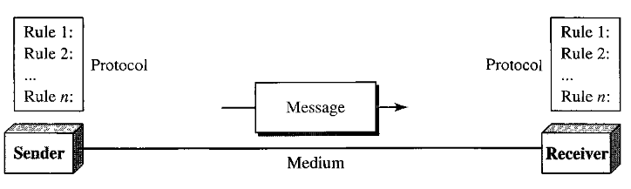
COMPONENTS OF DATA COMMUNICATION
A data communication system has 5 components
  1. Message – The information to be communicated
  2. Sender – The device that sends the message
  3. Receiver – The device that receives the message
  4. Medium – The path that the message travels
  5. Protocol – A set of rules that govern the data communication

Slide 6
DATA REPRESENTATION
Information today comes in different formats such as:
Text – Unicode, ASCII
Numbers
Images
Audio
Video

Slide 7
DATA FLOW
Communication between two devices can be of three types:
Simplex – Communication is unidirectional, only one device can transmit and the other will receive.
Half-duplex – Each station can send and receive, but only one at a time.
Full-duplex – Communication is bidirectional, both station can send and receive simultaneously

Slide 8
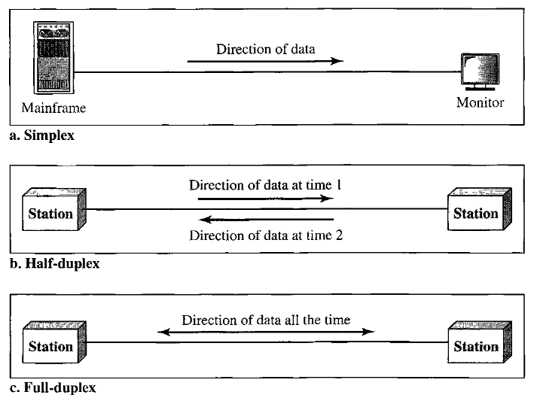
DATA FLOW (2)

Slide 9
NETWORKS
A network is a set of devices connected by communication links.
A node can be a computer, printer, or any other device capable of sending and/or receiving data generated by other nodes on the network.

Slide 10
NETWORK CRITERIA
A network must be able to meet a certain number of criteria. The most important of these are:
Performance – It depends on number of users, type of transmission medium, the capabilities of software and hardware
Reliability – Less frequency of failure
Security – Error detection and correction, Protecting from unauthorized access

Slide 11
PERFORMANCE OF A NETWORK
Performance can be measured by Transit time, Response time, Throughput and Delay.
Transit time is the amount of time required for a message to travel from one device to another.
Response time is the elapsed time between an inquiry and a response.
Throughput and delay.
  We often need more throughput and less delay. However, these two criteria are often contradictory.
  If we try to send more data to the network, we may increase throughput but we increase the delay because of traffic congestion in the network.

Slide 12
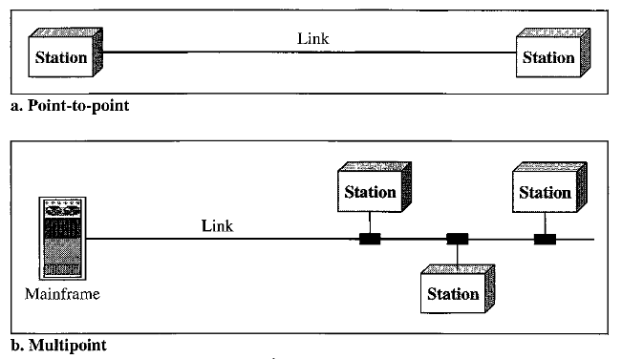
TYPE OF CONNECTION
Point-to-Point – Dedicated link between two devices
Multipoint – Two or more devices share a link

Slide 13
PHYSICAL TOPOLOGY
Two or more devices connect to a link; two or more links form a topology.
The topology of a network is the geometric representation of the relationship of all the links and linking devices (usually called nodes) to one another.
There are four basic topologies possible:
  mesh, star, bus, and ring

Slide 14
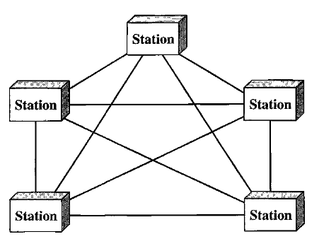
MESH

Slide 15
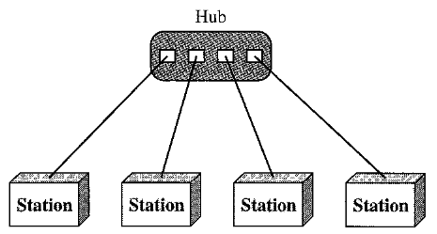
STAR

Slide 16
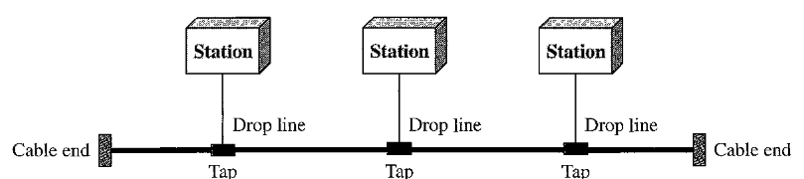
BUS

Slide 17
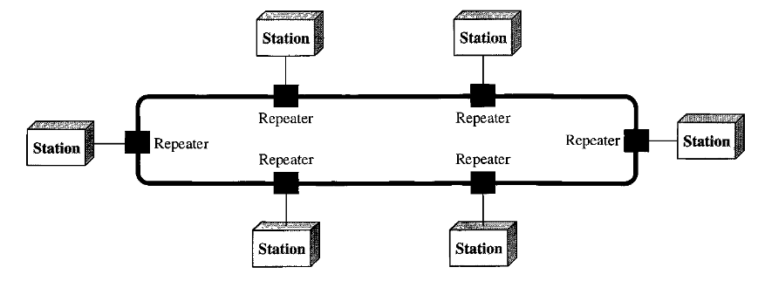
RING

Slide 18
CATEGORIES OF NETWORK
Today when we speak of networks, we are generally referring to two primary categories: local-area networks (LAN) and wide-area networks (WAN)
The category into which a network falls is determined by its size. A LAN normally covers an area of few kilometers; a WAN can be worldwide.
Networks of a size in between are normally referred to as metropolitan area networks (MAN) and span tens of miles.

Slide 19
INTERCONNECTION OF NETWORKS: INTERNET
A network is a group of connected communicating devices such as computers and printers.
An internet (note the lowercase letter i) is two or more networks that can communicate with each other.
The most notable internet is called the Internet (uppercase letter I), a collaboration of more than hundreds of thousands of interconnected networks. Private individuals as well as various organizations such as government agencies, schools, research facilities, corporations, and libraries in more than 100 countries use the Internet. Millions of people are users.

Slide 20
INTERNET: A BRIEF HISTORY
In mid 1960s, Advanced Research Projects Agency (ARPA) in the Department of Defense (DoD) was interested in finding a way to connect computers so that the researchers they funded could share their findings, thereby reducing costs and eliminating duplication of effort.
In 1969, ARPA created ARPANET. Four nodes, at the University of California at Los Angeles (UCLA), the University of California at Santa Barbara (UCSB), Stanford Research Institute (SRI), and the University of Utah, were connected to form a network. Software called the Network Control Protocol (NCP) provided communication between the hosts.

Slide 21
INTERNET: A BRIEF HISTORY (2)
In 1973, Vint Cerf and Bob Kahn's landmark paper outlined the protocols to achieve end-to-end delivery of packets. This paper on Transmission Control Protocol (TCP) included concepts such as encapsulation, the datagram, and the functions of a gateway.
Shortly thereafter, authorities made a decision to split TCP into two protocols: Transmission Control Protocol (TCP) and Internetworking Protocol (IP). IP would handle datagram routing while TCP would be responsible for higher-level functions such as segmentation, reassembly, and error detection. The internetworking protocol became known as TCP/IP.

Slide 22
THE INTERNET TODAY
The Internet has come a long way since the 1960s. Now a days, Internet is made up of many LANs and WANs are joined by connecting devices and switching stations.
It is difficult to give an accurate representation of the Internet because it is continually changing--new networks are being added, existing networks are adding addresses, and networks of defunct companies are being removed.
Today most end users who want Internet connection use the services of Internet service providers (ISPs). There are international service providers, national service providers, regional service providers, and local service providers. The Internet today is run by private companies, not the government.

Slide 23
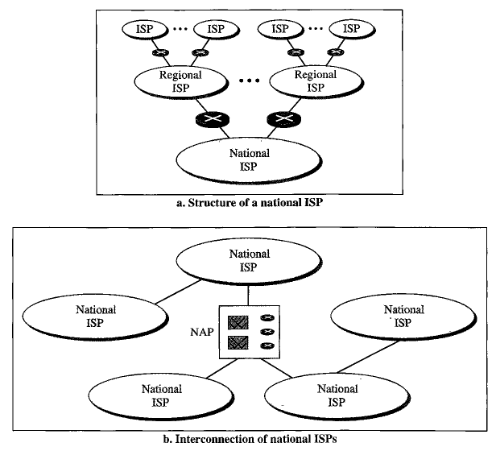
HIERARCHICAL ORGANIZATION OF INTERNET

Slide 24
PROTOCOL
A protocol is a set of rules that govern data Communications between entities in different systems.
The key elements of a protocol are syntax, semantics, and timing.
Syntax: The term syntax refers to the structure or format of the data, meaning the order in which they are presented. For example, a simple protocol might expect the first 8 bits of data to be the address of the sender, the second 8 bits to be the address of the receiver.

Slide 25
PROTOCOL (2)
Semantics: The word semantics refers to the meaning of each section of bits. For example, does an address identify the route to be taken or the final destination of the message?
Timing: The term timing refers to two characteristics: when data should be sent and how fast they can be sent. For example, if a sender produces data at 100 Mbps but the receiver can process data at only 1 Mbps, the transmission will overload the receiver and some data will be lost.

Slide 26
STANDARDS
Standards are necessary to ensure that products from different manufacturers can work together as expected.
The ISO, ITU-T, ANSI, IEEE, and EIA are some of the organizations involved in standards creation. (Check the elaboration of the acronyms!)
Forums are special-interest groups that quickly evaluate and standardize new technologies.
A Request for Comment (RFC) is an idea or concept that is a precursor to an Internet standard.

Slide 27
STANDARDS (2)
Data communication standards fall into two categories: de facto (meaning "by fact" or "by convention") and de jure (meaning "by law" or "by regulation").
De facto: Standards that have not been approved by an organized body but have been adopted as standards through widespread use are de facto standards. De facto standards are often established originally by manufacturers who seek to define the functionality of a new product or technology.
De jure: Those standards that have been legislated by an officially recognized body are de jure standards.

Slide 28
NETWORK MODELS

Slide 29
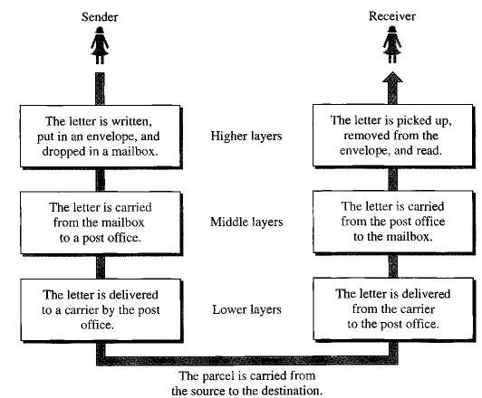
LAYERED TASKS

Slide 30
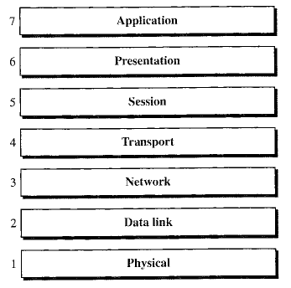
OSI MODEL
Open System Interconnection model => 7 layers

Slide 31
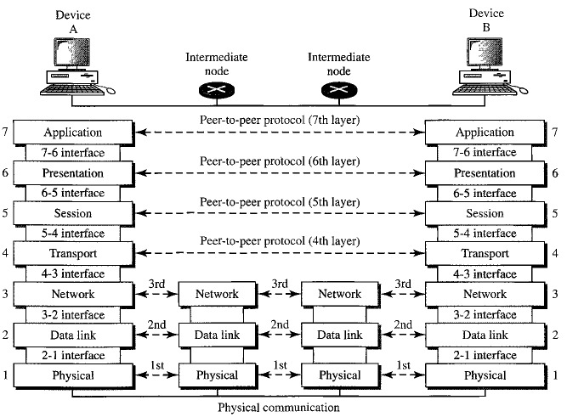
THE INTERCONNECTION BETWEEN LAYERS

Slide 32
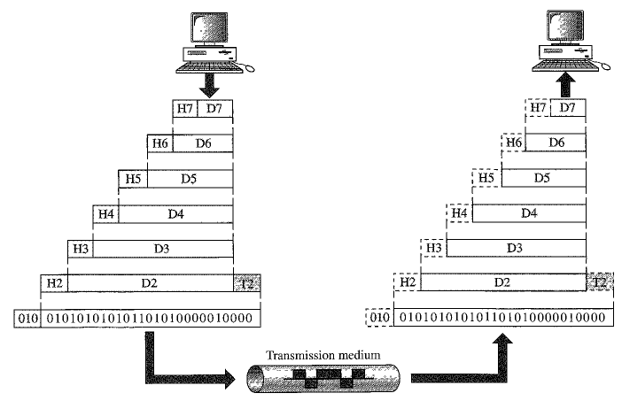
AN EXCHANGE USING OSI MODEL

